Slide 1
Macroeconomics

Slide 2
Dr. Asha Thomas
(Ph.D, MBA, PGBDM )
Assistant Professor,
Department of Operations Research and Business Intelligence Wroclaw University of Science and Technology, Poland Google Scholar

Slide 3
Economics is made up of two main areas
Microeconomics
Focuses on the behavior of individuals and firms and their allocation of scarce resources.
Macroeconomics
Focuses on the structure and performance of the economy as a whole.
(economic growth, price stability, limit unemployment)

Slide 4
Key terms
Private Sector- The private sector is the part of the economy that is run by individuals and companies for profit.
Public Sector- The public sector is the part of economy that is controlled by the government.
Factor Payment- Payment for the factors of production, namely rent, wages, interest, and profit.
Transfer Payment- Transfer payments are payments from the government to an individual for which no goods or service is exchanged, rather income is redistributed from one group to another.

Slide 5
Attendance (2 pts/ class)
Participation in class activities (2 pts/ class)
Assignments (7)
Project Presentation/discussions
Final project report

Slide 6
The Economy’s Income and Expenditure
For an economy as a whole, income must equal expenditure because:
Every transaction has a buyer and a seller.
Every dollar of spending by some buyer is a dollar of income for some seller.
Say’s Law-Supply creates it’s own demand
This process can be seen using a Circular Flow Diagram.

Slide 7
The Circular-Flow Diagram
Revenue
Market for
Goods
and Services
Spending
Goods & Services sold
Goods & Services bought
Firms
Households
Inputs for production
Labor, land, and capital
Market for
Factors
of Production
Wages, rent, and profit
Income
Notes:
7

Slide 8
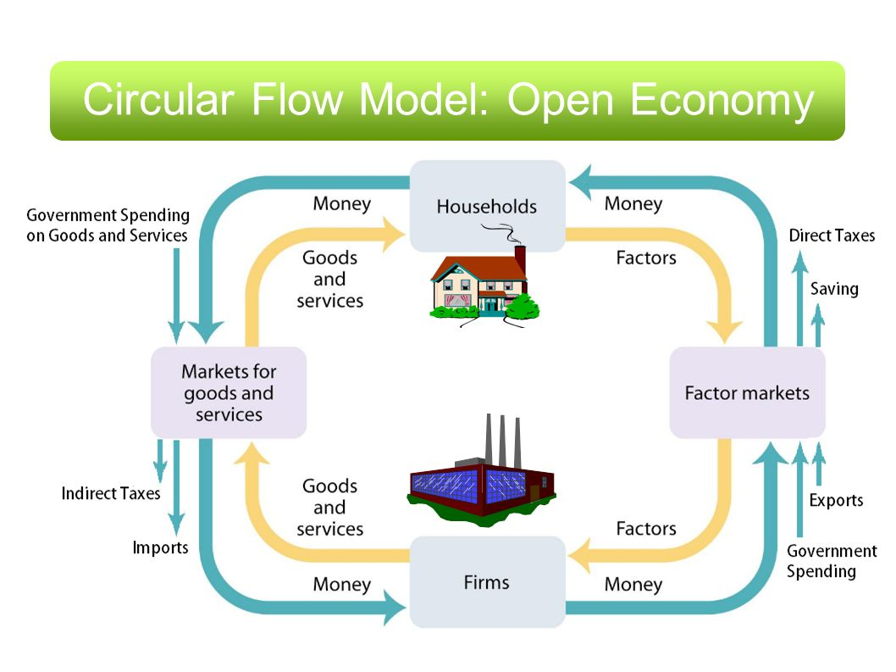
Film: https://www.youtube.com/watch?v=mN5HPJYJzus

Slide 9
Difference between GDP and GNP
Gross Domestic Product
The most commonly used measure of a country’s national income is GDP
GDP may be defines as the total of all economic activity in a country , regardless of who owns the productive assets.
GDP has to do with the physical location, where it’s actually made!

Slide 10
Gross Domestic Product
Gross domestic product (GDP) is a measure of the income and expenditures of an economy.
It is the total market value of all final goods and services produced within a country in a given period of time.

Slide 11
Gross National Product
GNP is the total income that is earned by a country’s factors pf production regardless of where the assets are located.
GNI is equal to GDP + income earned from assets abroad - income paid to foreign assets operating domestically.
GNI = GDP + net property income from abroad

Slide 12
The Components of GDP
GDP (Y ) is the sum of the following:
Consumption (C)
Investment (I)
Government Purchases (G)
Net Exports (NX)
Y = C + I + G + NX

Slide 13
GDP is the dollar value of all final goods and services produced within a country in one year.
Final goods- GDP only counts NEW goods and services.
Within a country- GDP measures production within the country’s borders.
One year- GDP measures annual economic performance.

Slide 14
Final goods
In economics final goods are goods that are ultimately consumed rather than used in the production of another good.
For example, a car sold to a consumer is a final good;
The components such as tires sold to the car manufacturer are not; they are intermediate goods used to make the final good.

Slide 15
Three ways of calculating GDP
Expenditure Approach
Consumption (C)
Investment (I)
Government Purchases (G)
Net Exports (NX)
Y = C + I + G + NX

Slide 16
Income Approach
Labor Income
Rental Income
Interest Income
Profit

Slide 17
Value added
Value added refers to the additional value of a commodity over the cost of commodities used to produce it from the previous stage of production.
It refers to the contribution of the factors of production, i.e., land, labour, and capital goods, to raising the value of a product and corresponds to the incomes received by the owners of these factors.
In national accounts such as the United Nations System of National Accounts (UNSNA), gross value added is obtained by deducting intermediate consumption from gross output. Thus gross value added is equal to net output.

Slide 18
The Measurement of GDP
GDP is: GDP can be defined in three ways, all of which are conceptually identical.
First, it is equal to the total expenditures for all final goods and services produced within the country in a stipulated period of time (usually a 365-day year).
Second, it is equal to the sum of the value added at every stage of production (the intermediate stages) by all the industries within a country, plus taxes less subsidies on products, in the period.
Third, it is equal to the sum of the income generated by production in the country in the perio

Slide 19
Value-added Approach
Add up the dollar/Pln value added at each stage of the production process.
In production process we go from raw materials to finished goods and along the way there’s value added by different companies and that value added can be added up and that’s a value added approach.

Slide 20
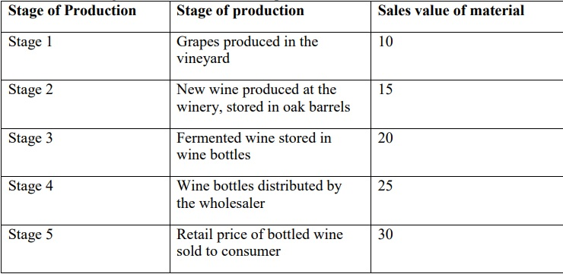
Solve

Slide 21
Assuming that no intermediate inputs are used other than the ones named, what is the value added at each stage of production – Stage 1-5?
b. Using the value added approach, what is the total contribution to the GDP of this chain of production?
c. Using the expenditure approach, what is total contribution to the GDP of this good? Explain why the number you got in part c is (or is not) the same as that from part b

Slide 22
What Is Counted and Not Counted in GDP?
GDP includes all items produced in the economy and sold legally in markets.
GDP excludes services that are produced and consumed at home and that never enter the marketplace.
GDP also excludes black market items, such as illegal drugs.

Slide 23
GDP and Its Components
Government Purchases
18%
Investment
16%
Net Exports
-2 %
Consumption
68 %

Slide 24
Measuring Economic Growth
We use real GDP to calculate the economic growth rate.
The economic growth rate is the percentage change in the quantity of goods and services produced from one year to the next.
We measure economic growth so we can make:
Economic welfare comparisons
International welfare comparisons
Business cycle forecasts

Slide 25
Measuring Economic Growth
Business Cycle Forecasts
Real GDP is used to measure business cycle fluctuations.

Slide 26
Real versus Nominal GDP
Nominal GDP values the production of goods and services at current prices.
Real GDP values the production of goods and services at constant prices.

